Slide 1


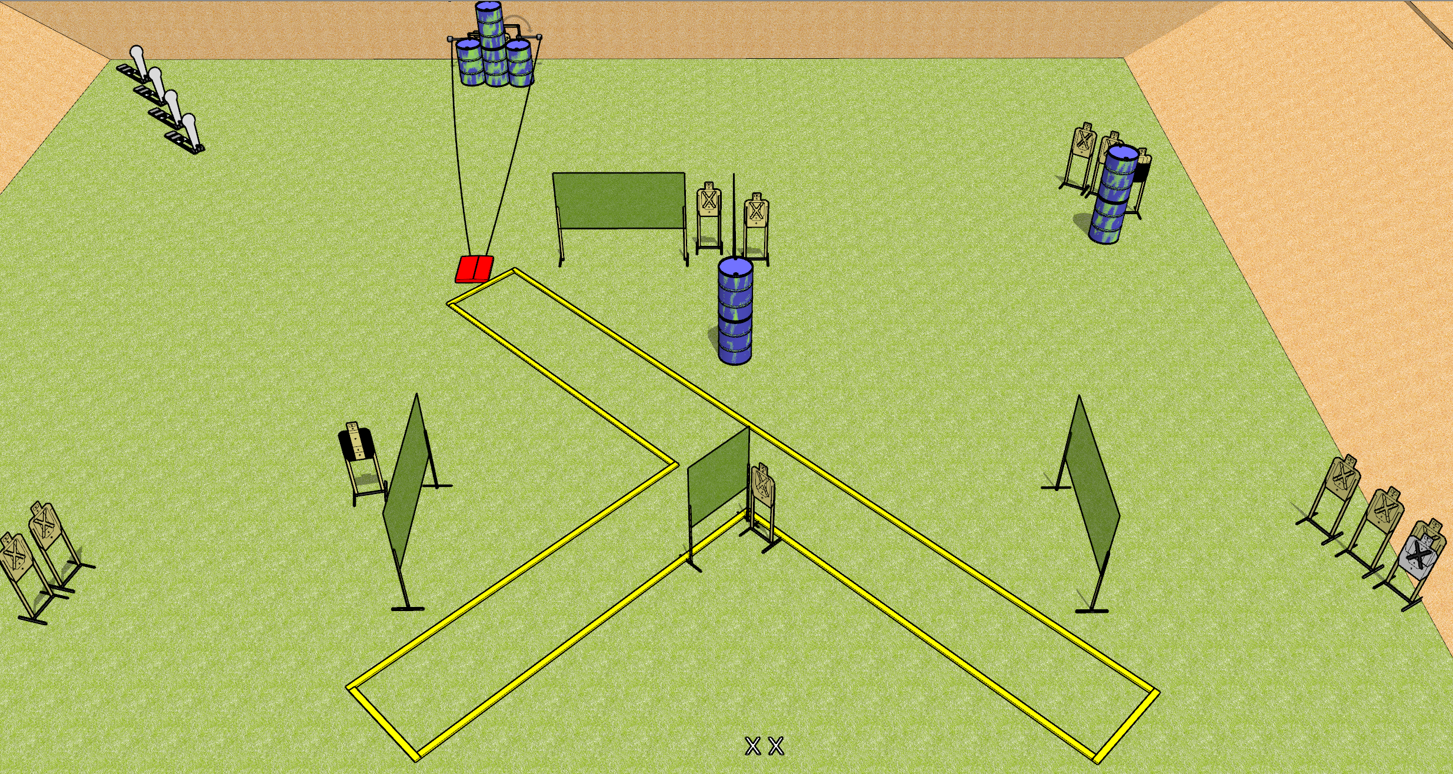
 | Dothan Gun Club – USPSA Match Y Course Designer : Drew Coleman
START POSITION : Standing with both feet on X’s, wrists below belt
GUN READY CONDITION : Pistol loaded and holstered. PCC loaded, held with both hands, shouldered, safety on. |  | SCORING: Comstock, 32 rounds TARGETS: 14 paper, 4 Steel SCORED HITS: Best 2 on paper, steel until down START-STOP: Audible, last shot RULES: Swinging targets must be activated before being engaged.
STAGE PROCEDURE: Engage targets as they become available from within the fault lines.

Slide 2
Y
Written Stage Briefing
Y is a 32 round, 160 point, Comstock field course. There are fourteen USPSA targets and four Colt poppers. The best two hits on paper will score, and steel must fall to score. The start signal is audible.
The stomp box activates the swinging targets. Swinging targets must be activated before being engaged. Please check the activators prior to walkthrough and set the same way for every shooter.
Handgun start position is standing with both feet on X’s, wrists below belt. Handgun is loaded and holstered.
PCC start position is standing with both feet on X’s. Loaded carbine is held with both hands, shouldered, safety on.
On start signal, engage targets as they become available from within the fault lines.

